Slide 1
Computer vision driving aids an adaptation of adas to the android platform
Traffic sign recognition
Lane departure detection and warning
Collision and obstacle avoidance
Notes:
Adam

Slide 2
Team members
Belorkar, Sapana Senior Quality Assurance Engineer, Insurance Industry
Burbidge, Adam (Team Leader) Systems/Software Engineer, Pratt & Whitney
Roseberry, Keith Software Technical Fellow, UTC Aerospace Systems
Varadaraju, Rakshith Software Engineer, Rockwell Collins
Notes:
Adam

Slide 3
Project overview
Using an Android Mobile Phone or a Raspberry Pi 3 B+ and a camera module, develop computer vision processing to perform the following functions
Project will attempt one or more of:
Collision and Obstacle Avoidance: Detect obstacles in the path of the vehicle to predict collisions and warn the operator.
Traffic Sign Recognition: Read traffic signs, most importantly speed limit signs, to determine appropriate driving behavior.
Lane Departure Detection and Warning: Determine when the vehicle is departing from its travel lane and warn the operator. Requires recognition of a travel lane.
Notes:
Adam

Slide 4
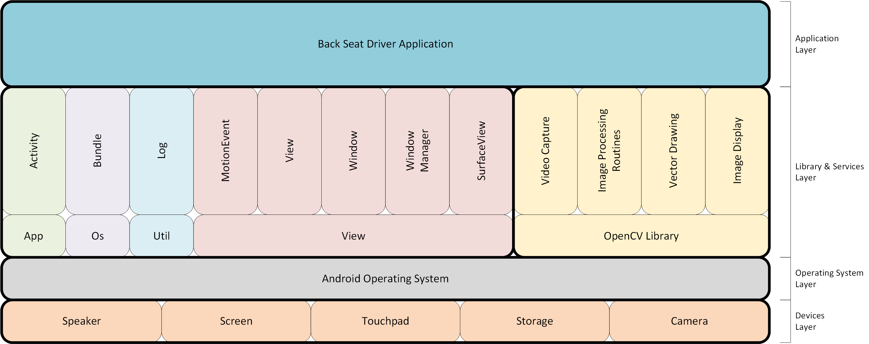
Software Architecture – logical view
Notes:
Keith

Slide 5
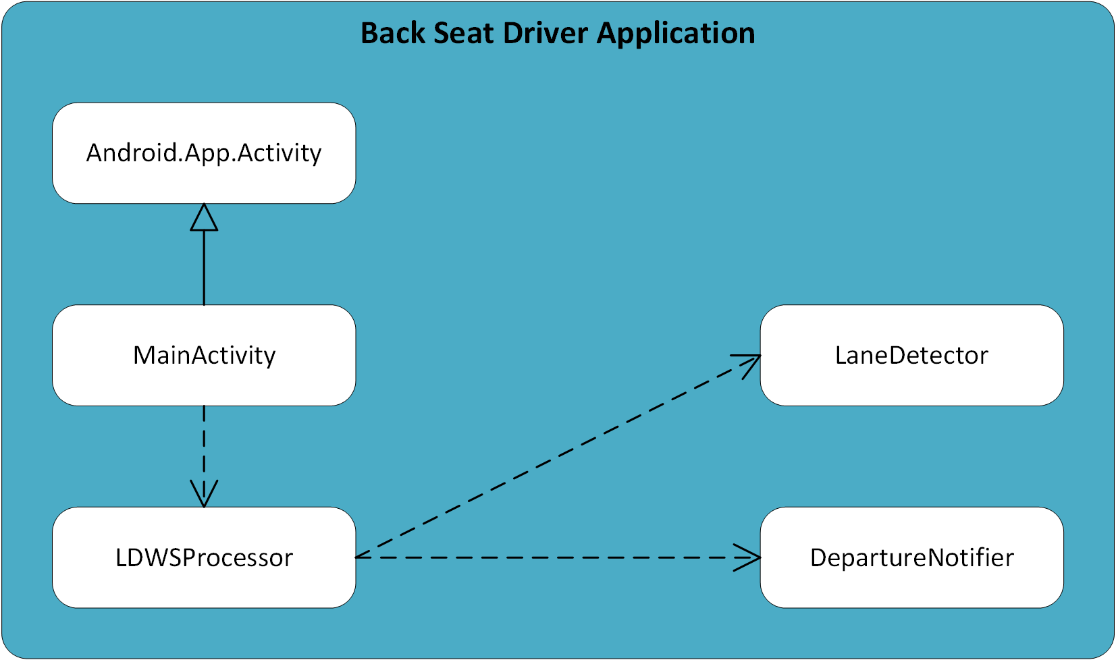
Software Architecture – logical view
Notes:
Keith

Slide 6
Software architecture - goals
Extensibility
MainActivity invokes additional "processor" classes
Modularity
Partitioning of the major sub-functions of the application functionality into separate classes
Team members work independently on the classes.
Performance
Streamlining of the processing into a serial/pipeline methodology
MainActivity invokes the LDWSProcessor class
LDWSProcessor invokes the LaneDeparture class
LDWSProcessor invokes the DepartureNotifier class

Slide 7
Software Architecture – process view
Notes:
Keith

Slide 8
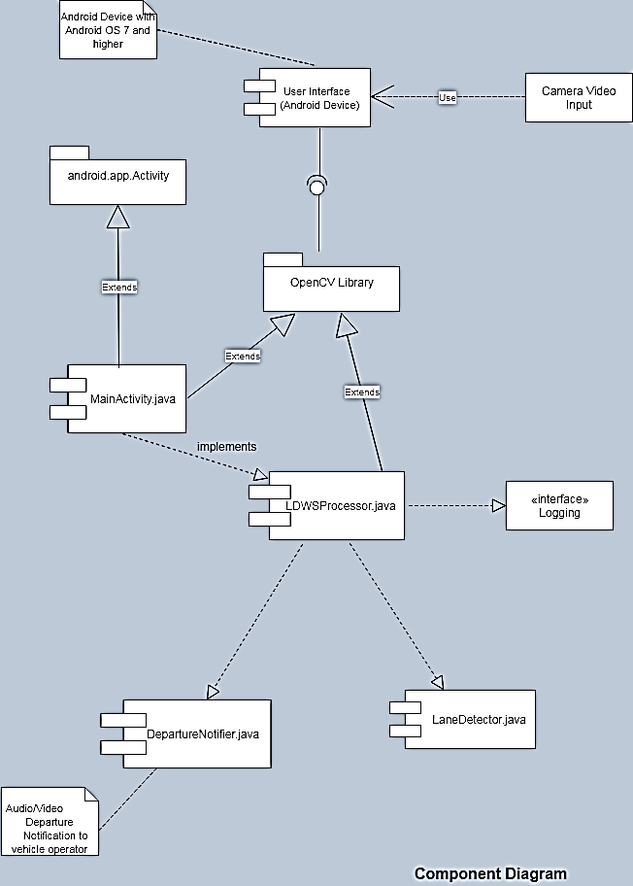
Software Architecture – development view
Notes:
Sapana

Slide 9
Software Architecture – scenarios
Notes:
Keith

Slide 10
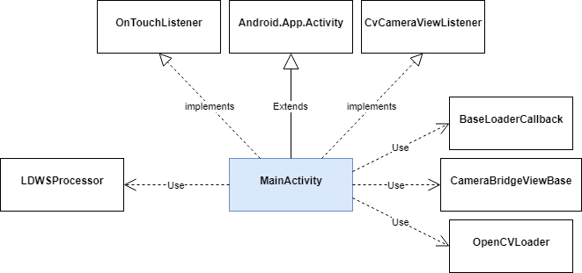
MainActivity Class

Slide 11
ldwsprocessor Class

Slide 12
lanedetector Class

Slide 13
departurenotifier Class

